Slide 1



March Data Crunch Madness
Millennial Miners
Janelle
Cordero
Angela
Krontiris
Runbo
Li
Tianyi
Zhang
Sporting News

Slide 2
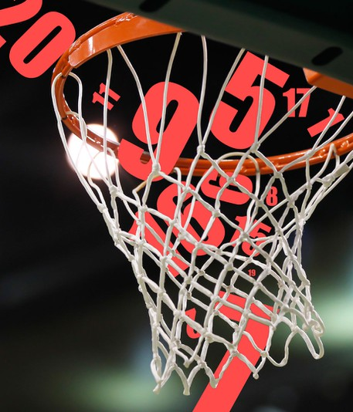
Data Preprocessing
Creating target label
Imputing missing values
Modifying data types
Creating dummy variables

Slide 3


Creating Target Label
Modifying Data Types
The data was provided such that team 1 was always the winning team.
We randomly selected half of the data and swapped their team 1 and team 2 variables
We created a binary “team1_outcome” variable. 1 = a team1 win and 0 = a team1 loss.
We converted team ID variables to a string so it could be interpreted as an object since this variables has no quantitative meaning or order.
7 → ‘7’
Team 1
int
object
1
Team 2
float
0

Slide 4

Imputing Missing Values
Defining and Creating Dummy Variables
The AP ranking variables only includes a value if a team is a top 25 ranked team.
Since these variables are quantitative and ordinal, we substituted NAN’s with the value 26 to make the distinction that the teams ranked worse than the top 25 teams and they are all equally ranked.
Provided
Defined
One-Hot Encoding
Team1_region
W
Z
Y
X
Team1_region
East
West
South
Midwest
Team1_ East | Team1_West | Team1_South | Team1_ Midwest
1 | 0 | 0 | 0
0 | 1 | 0 | 0
0 | 0 | 1 | 0
0 | 0 | 0 | 1
AP RANKING POLL
1
2
3
4
. . .
24
25
26

Slide 5

Feature Engineering & Feature Selection
Relevant Data
Eliminate
Engineer
Validate
Finding external datasets/collecting data
Determining final set of features

Slide 6






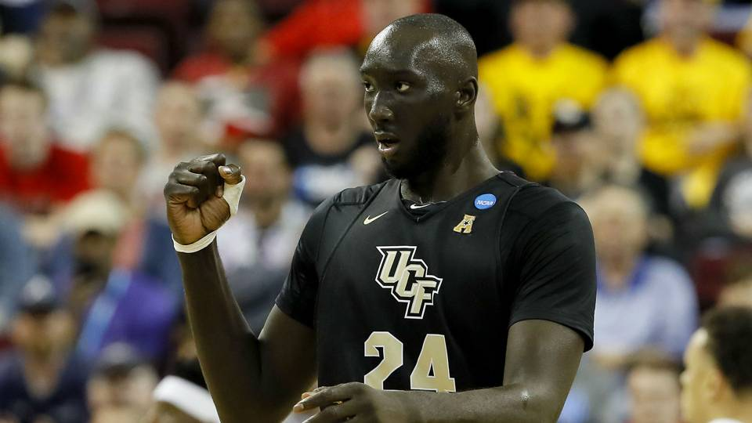
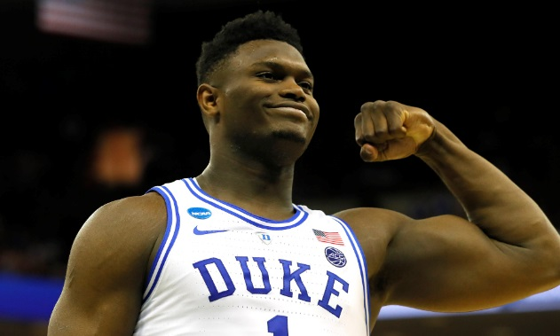
Features Created and Added
Distance from host
Conference
Conference information
Number of NCAA championships won within the conference
Number of times a school in the conference advanced to the Final Four
Number of times a school entered the March Madness NCAA Tournament
General Player Information
Number of current season top 10 players (minutes)
Number of current season top 10 players (field goals)
Number of current season top 10 players (blocks)
Number of current season top 10 players (points)
General School basketball team stats
Years in the league
Wins/losses
W-L%
SRS
SOS
Public/Private
NCAA Appearance Last Year
NCAA Appearance in the last three years

Slide 7

Train & test set
After training on several subsets of season intervals and testing on seasons 2017 and 2018, the last 5 years of data produced the best results.
x1 | x2 | x3 | x4 | y
Final Train/test
set
Seasons
2014 - 2018
Season
2019
All quantitative features were scaled using MinMax scaler

Slide 8

Final 25 features using Lasso
team 2 seed
Team 1 coach career losses
Team 2 coach Poll rank before the final
team 1 AP Poll rank
Team 2 coach Poll rank before the final
Team 1 coach preseason poll ranking
Team 2 defensive efficiency
Team 1 region – Midwest (0/1)
Number conference championship wins in team 1’s conference
Number of final four appearances of teams in team 2’s conference
Number of NCAA Tournament appearances of teams in team 2’s conference
Number of team 1’s players that are overall current season top 10 in minutes
Number of team 1’s players that are overall current season top 10 in field goals
Number of team 1’s players that are overall current season top 10 in points
Number of team 2’s players that are overall current season top 10 in minutes
Number of team 1’s players that are overall current season top 10 in points
Team 1’s appearance in the NCAA tournament last year (0/1)
Team 1’s appearance in the NCAA tournament in the last 3 years (0/1)
Team 2’s appearance in the NCAA tournament in the last 3 years (0/1)
Team 1 conference - Southeastern (0/1)
Team 2 conference – Atlantic Coast (0/1)
Team 2 conference – Big 12 (0/1)

Slide 9
Modeling & Predictions
Model Selection
Log Loss

Slide 10
Final Results on 2018 data
Tested several classification models
Logistics Regression
Support Vector Machine
Random Forest
kNN
Ensemble: Average of all predictions
Ensemble: Majority vote (not a probability)
SVM produced the smallest log loss
As of 3/27/19:
Log loss = 0.46
Accuracy = 77%
Model | Log Loss | Accuracy
Logistic Regression | 0.58 | 73%
SVM | 0.53 | 73%
Random Forest | 0.54 | 72%
kNN | 0.55 | 63%
Average | 0.54 | 75%
Majority Vote |  | 73%

Slide 11
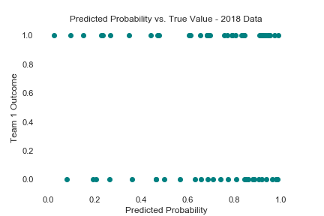
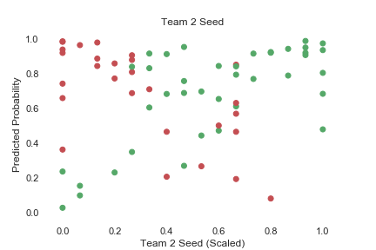
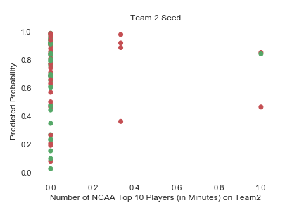
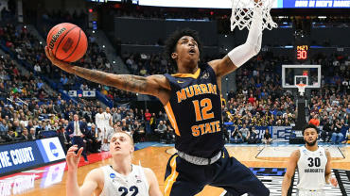
Predictions
Model
Team 1 win
Team 1 loss
When team 2 had a high seed value, it was predicted that team 1 would win (and predictions are usually correct after a certain threshold).
When team 2 had 1 or more top 10 players, it was predicted that team 1 would lose. This prediction was usually correct, except for one instance (2018 – Syracuse vs Duke).

Slide 12


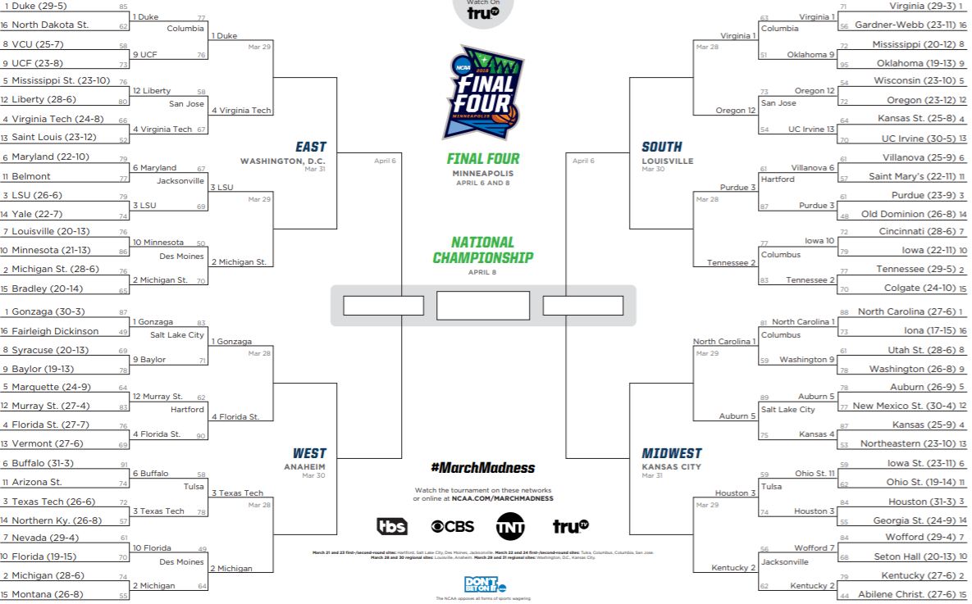
Predictions as of 3/27/19
Duke: 73%
Virginia: 92%
Duke: 71%
Virginia: 60%
LSU: 58%
Purdue: 89%
Duke: 72%
Virginia: 64%
Virginia: 71%
Florida St: 62%
North Carolina: 89%
Florida St: 77%
Kentucky: 79%
Texas Tech: 83%
Kentucky: 60%

